Slide 1
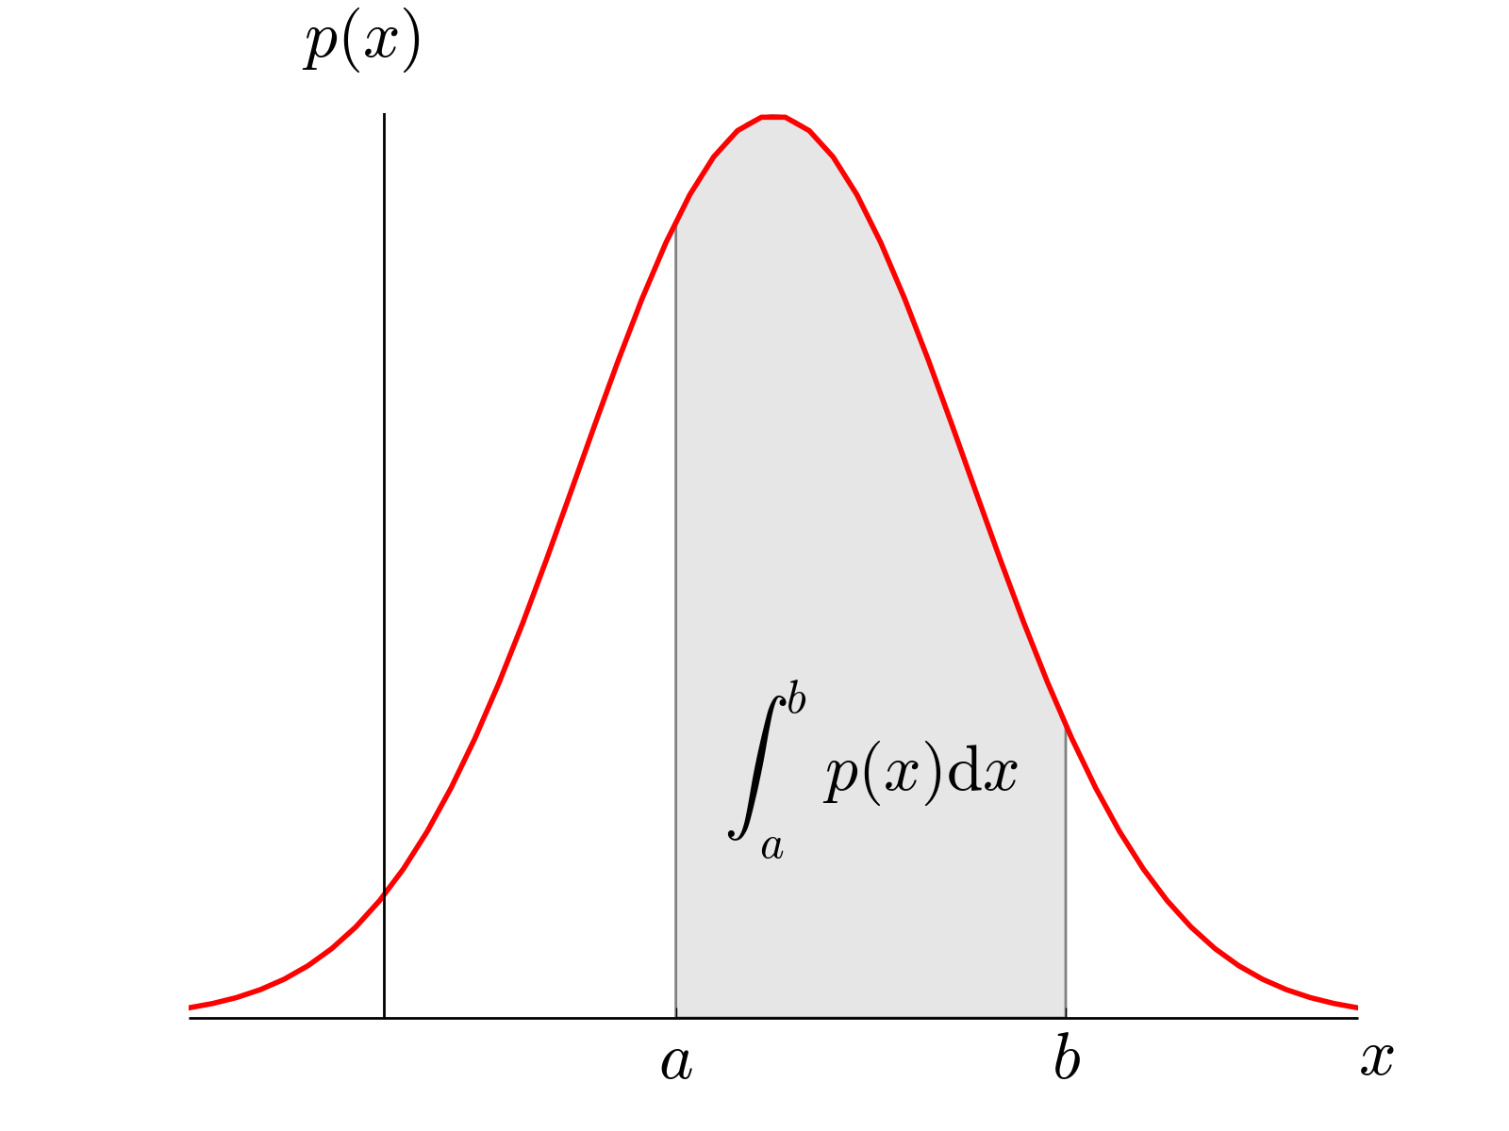
Continuous Probability Distributions
ρ(x) – Probability Density Function
Normalization
Mean or “expected value”

Slide 2
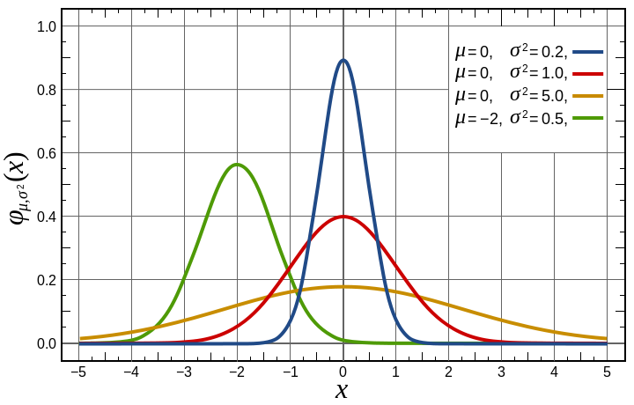
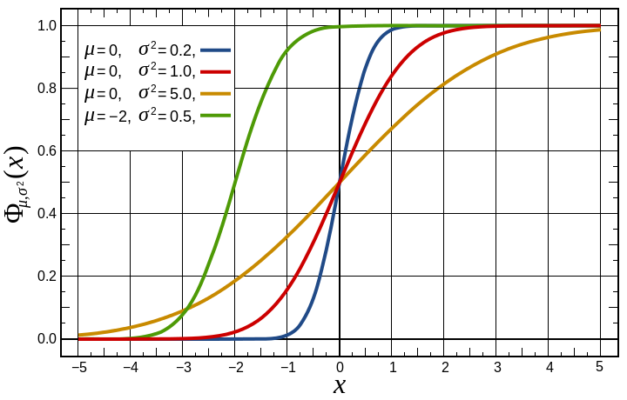
Gaussian Distribution
Central Limit Theorem – For large N, most distributions become Gaussian
Gaussian PDF
Gaussian CDF

Slide 3
Probability Density Functions
Calculate mean and standard deviation.
➔Use CDF or z-table to compute probability.
We are essentially “curve fitting” the discrete histogram with a continuous PDF.

Slide 4

Measuring Probability
Poisson Statistics
Discrete “Counting” experiments.
Continuous Distributions
Determine and standard deviation to “curve fit” histogram with PDF
Measured Probability

Slide 5


Product Safety
People’s lives are in your hands!
United Airlines Flight 811
Aloha Airlines Flight 243
Insufficient locking mechanism on cargo bay door of Boeing 747.
Rupture in fuselage roof of Boeing 737.

Slide 6
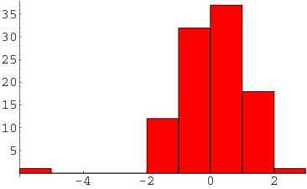
Ethical Handling of Data
Why might it be unethical to throw out data?
What are some legitimate reasons to disregard data?
Outliers ➔ Grubbs’ Test
For N > 50
http://mathworld.wolfram.com/Outlier.html

Slide 7
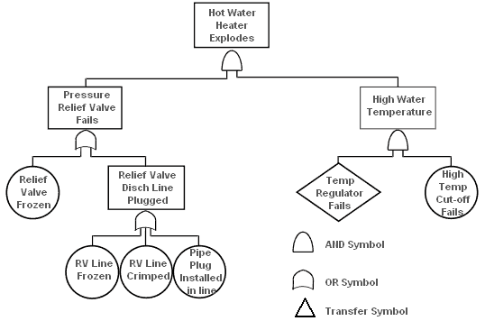
Fault Tree Analysis

Slide 8
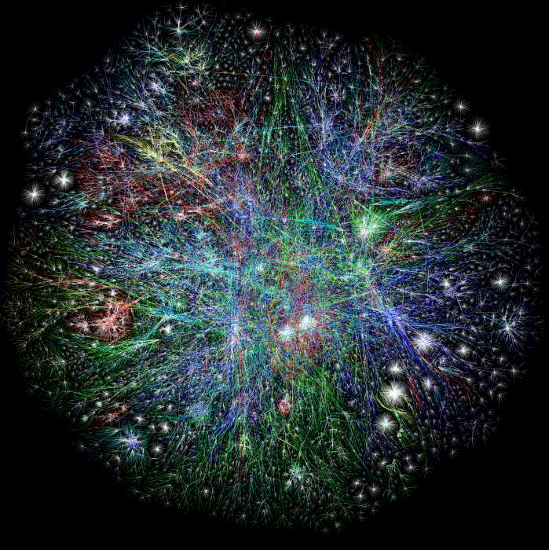


Network Reliability
Networks show up everywhere:
Communications (i.e. the internet)
Electrical grids
Social networks
Economics
National Security

Slide 9


Monte Carlo Calculations
Consider taking random shots at this board.
Counted N = 20,857 bullet holes
Probability of landing in the circle:
Measured
π = 3.132
arXiv:1404.1499v2

Slide 10
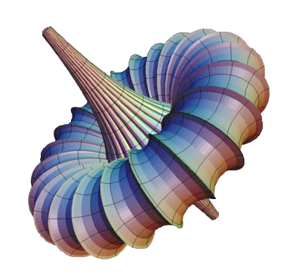
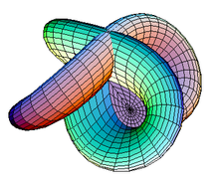
Monte Carlo Calculations
Often used to numerically evaluate complex integrals.
i.e. What’s the volume enclosed in these surfaces?

Slide 11
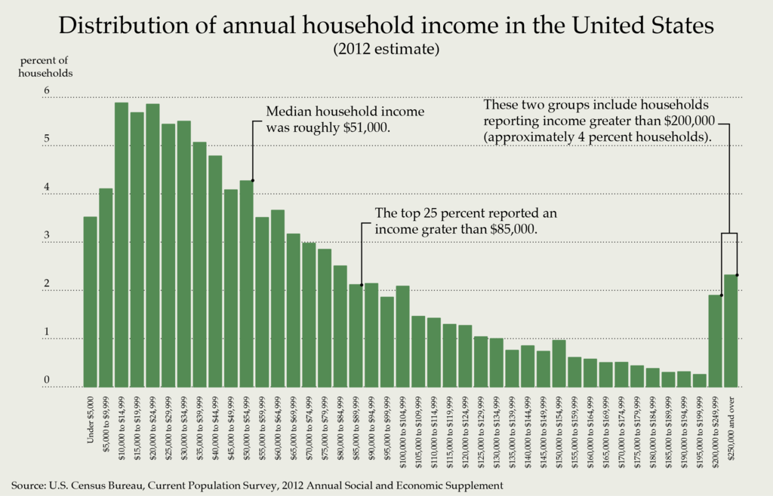

Slide 12
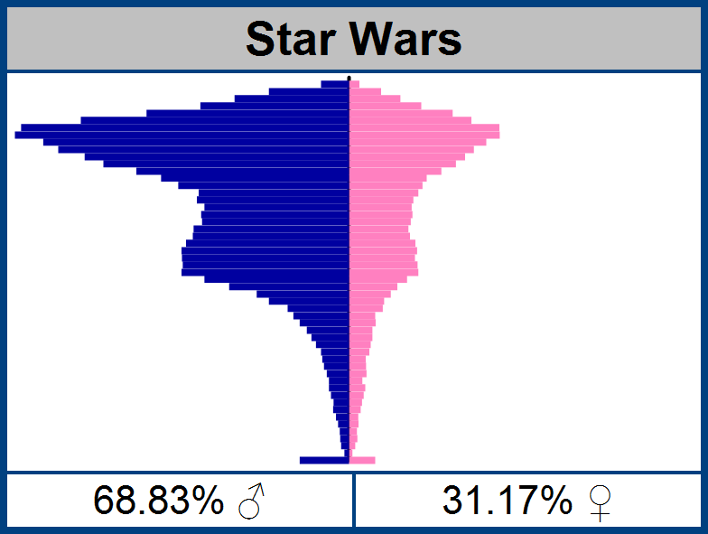
“Bimodal” distribution

Slide 13
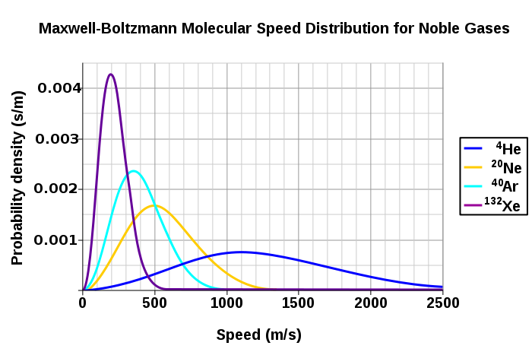
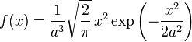
Statistical Thermodynamics

Slide 14
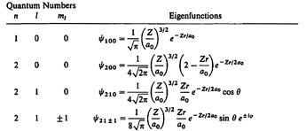
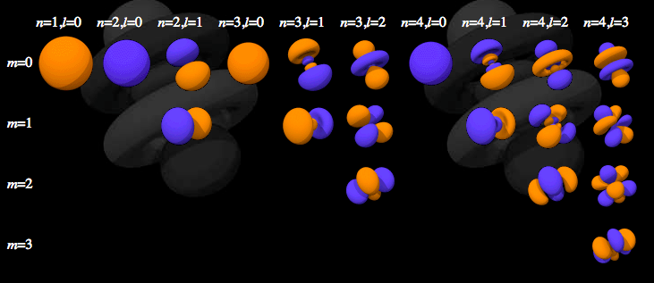
Electron Orbitals
Electron orbitals are also probability density functions
(probability per unit volume)

Slide 15
Other Courses in Probability
AME50561 – Reliability in Engineering (Ovaert)
ACMS10145 – Stats for Business I
ACMS20340 – Statistics for Life Sciences
ACMS30530 – Intro to Probability
ACMS30540 – Mathematical Statistics
ACMS30600 – Stat Methods & Data Analysis
ACMS37020 – Projects in Actuarial Science
ACMS40875 – Stat Methods in Data Mining
MATH40210 – Basic Combinatorics
PHYS70152 - Intro to Network Science

